Slide 1

Water Tank Level Controlling Using Arduino
Mini Project
By
V. Venu (22481A04N9)
B. Saniya (22481A04L3)
Sk. Shabana (22481A04M1)
Y. Gopal Krishna (22481A04P2)
Instructor: Dr. Ch. Bala Swamy, MTech, PhD(Professor)
1

Slide 2
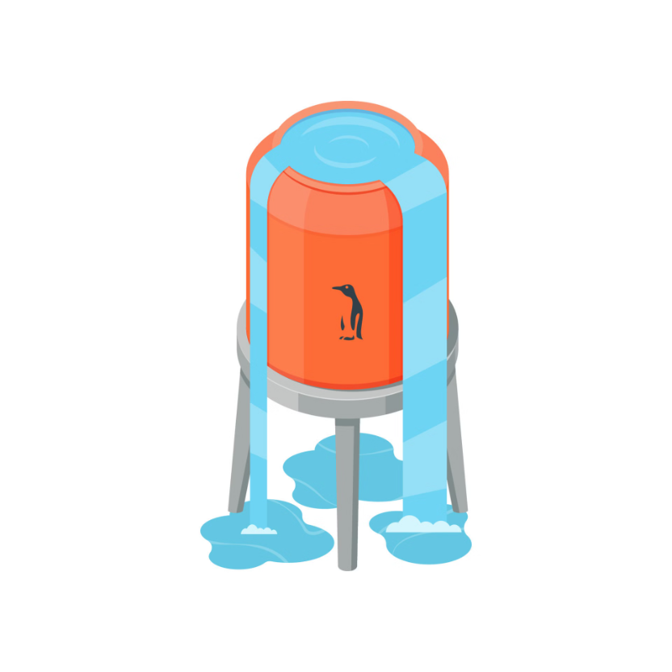
Project Overview
Objective
To automate water level control in tanks using ultrasonic sensors and Arduino, minimizing water and electricity waste.
Benefits
Reduces water overflow
Saves electrical energy
Low cost and easy installation

Slide 3
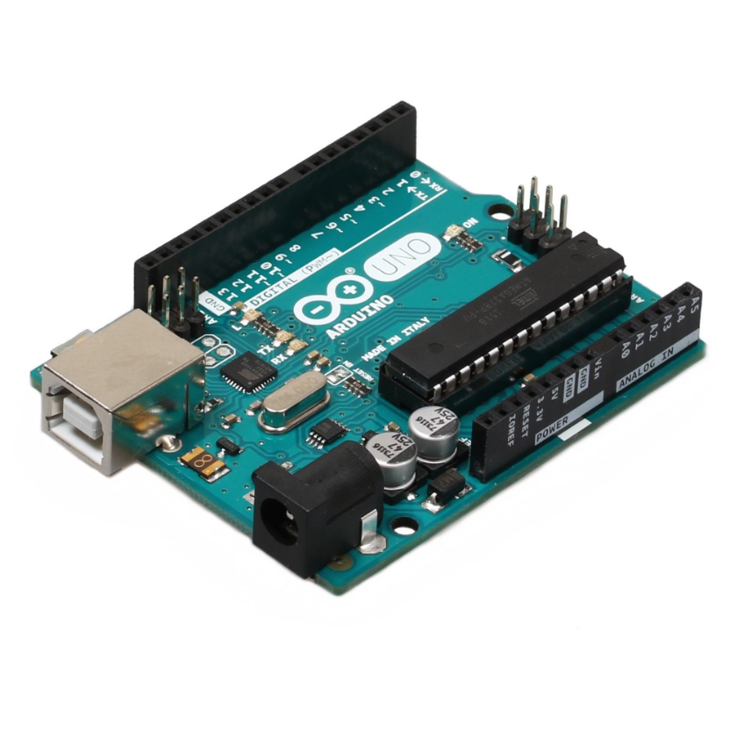
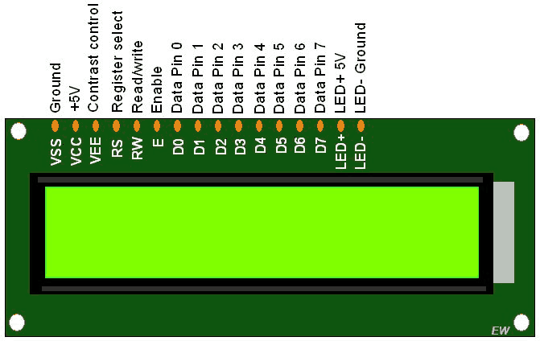
Key Components:
Arduino uno microcontroller
The brain of the system, processing sensor data and controlling the pump.
ATmega328 based
14 digital I/O pins
USB connectivity
LCD Display
Display water level percentage, display pump ON and OFF

Slide 4
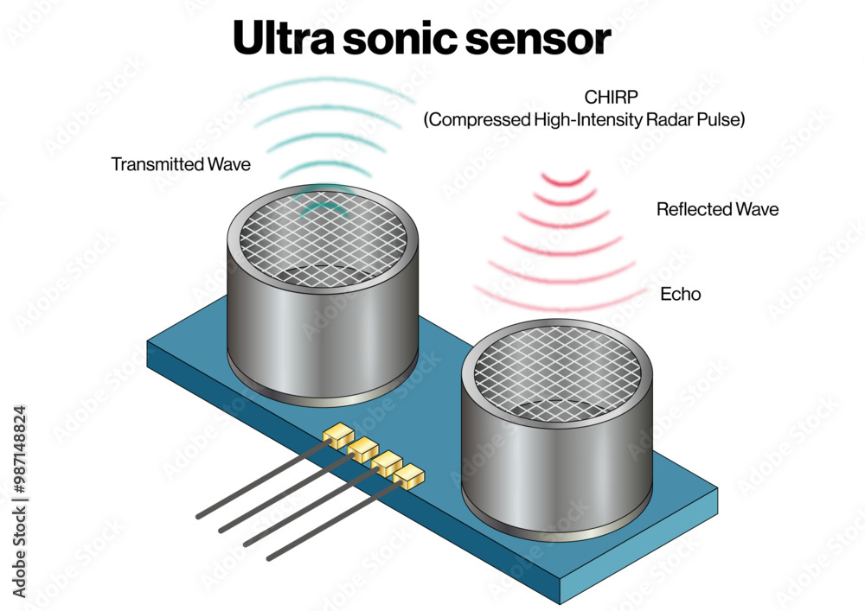
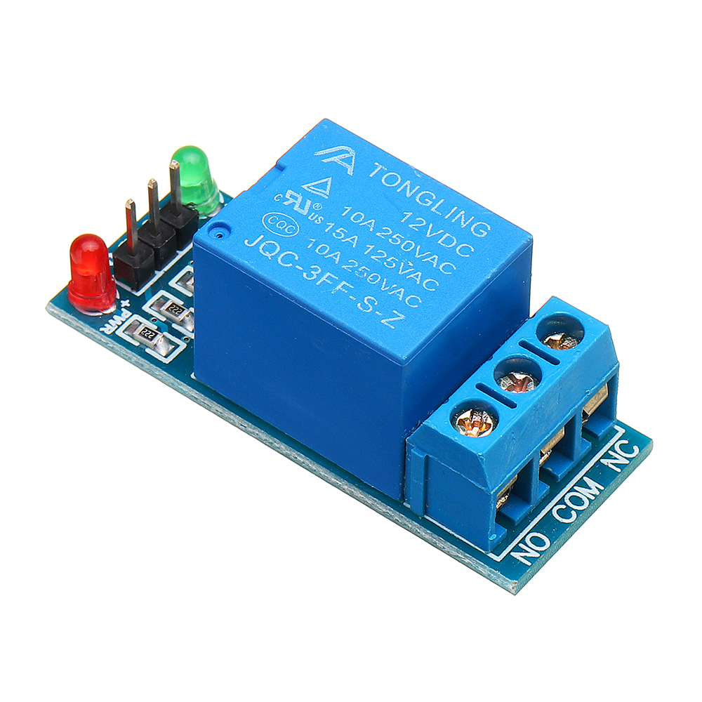
Ultrasonic Sensor Applications
Ultrasonic sensor that works using the principle of EHCO. The sensor transmits ultrasonic waves, which reflect back upon hitting an obstacle(in this case, water surface). By measuring the time delay between transmission and reception, the distance to the water surface is calculated
Relay Switch
The relay is an electrically operated switch that allows a low power Signal (from microcontroller like Arduino ) to control a high-power device (like a bulb or motor)
4

Slide 5
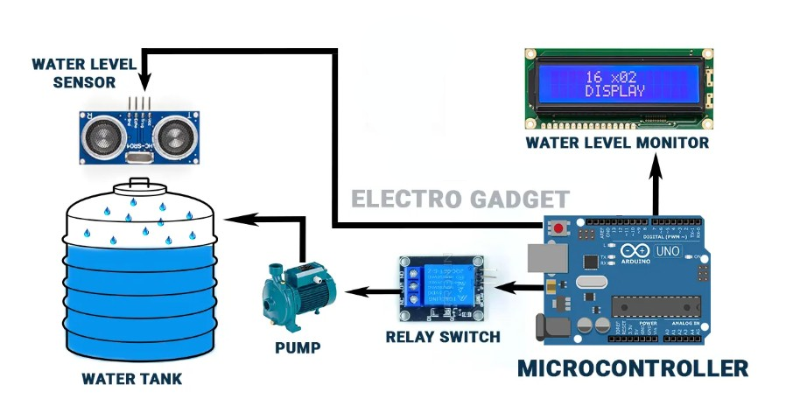
Block Diagram
5

Slide 6
Source Code
// include the library code:
#include <LiquidCrystal.h> //library for LCD
// initialize the library with the numbers of the interface pins
LiquidCrystal lcd(13, 12, 11, 10, 9, 8);
// defines pins numbers
const int trigPin = 5;
const int echoPin = 6;
const int Motor_Pin = 7;
// defines variables
long duration;
int distance;
bool Motor; //Make a bool Function for Motor ON/OFF
void setup()
{
pinMode(trigPin, OUTPUT); // Sets the trigPin as an Output
pinMode(echoPin, INPUT); // Sets the echoPin as an Input
pinMode(Motor_Pin, OUTPUT); // Sets the Motor Pin as an Output
// set up the LCD's number of columns and rows:
lcd.begin(16, 2); //LCD order
}
void loop()
{
// Clears the trigPin
digitalWrite(trigPin, LOW);
delayMicroseconds(2);
// Sets the trigPin on HIGH state for 10 micro seconds
digitalWrite(trigPin, HIGH);
delayMicroseconds(10);
digitalWrite(trigPin, LOW);
// Reads the echoPin, returns the sound wave travel time in microseconds
duration = pulseIn(echoPin, HIGH);
// Calculating the distance in cm
distance = duration*0.034/2;
int Level = map(distance, 0,1106, 0,100);
// Prints the distance on the LCD
lcd.setCursor(0,0);
lcd.print("Water: ");
lcd.print(Level);
lcd.print("% ");
if(Level < 30) //if Water Level is Less than 30%
{
Motor = true; //Make The Bool True
}
if(Level >= 100) //if Water Level is Greater than or Equal to 100%
{
Motor = false; //Make The Bool False
}
if(Motor) //if Bool is True
{
digitalWrite(Motor_Pin, HIGH);
lcd.setCursor(0,1);
lcd.print("Pump: ON ");
}
else //if Bool is False
{
digitalWrite(Motor_Pin, LOW);
lcd.setCursor(0,1);
lcd.print("Pump: OFF ");
}
}

Slide 7
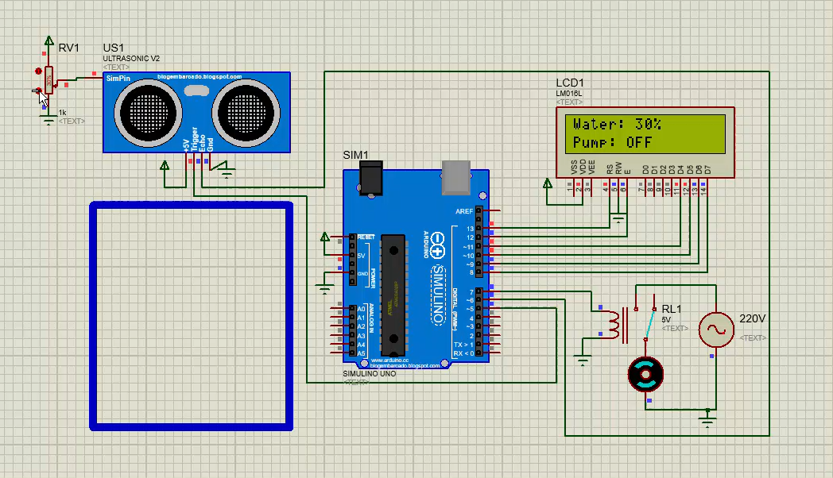
System Design: Working
& Simulation
The Ultrasonic sensor is fixed at the top of the tank to measure the water surface distance
The Arduino processes this data and decides whether to turn the pump ON or OFF
When the water level is below the 30%, the relay module activates the pump
When the water level reaches the 100%, the pump is turned OFF pump
An optional LCD can display the current water level

Slide 8
Applications Across Sectors
Residential
Commercial
Automated home water tanks
Municipal water systems
Boiler water level control
Chemical processing plants
Agriculture
Irrigation systems
Aquaculture & Fisheries
The system can control water levels in storage tanks, pools, and fuel tanks. Additional use in oil tank level controlling.
8

Slide 9
Advantages and Disadvantages
Advantages
Disadvantages
Low maintenance
Low power consumption
Customizable
Prevents overflow & wastage
Sensor needs replacement
Wiring complexity
9

Slide 10


Conclusion and Future Scope
Wireless Control
Mobile Integration
The automatic water level controller reduces water wastage, reduces electricity consumption. Future enhancements include wireless control, mobile app integration. It has high potential in agriculture.
10

Slide 11
Thank You
11

